Slide 1

Adjustment of covariates in causal inference
By Nermina Logo, Rodrigo Jiménez and Inés García

Slide 2
Main points
Objective
Methodology
Common cause cases
Common effect cases
Complex cases
Room to improve
Conclusions

Slide 3
Objectives
The goal of this project is to illustrate what difficulties could appear when doing causal inference in the adjustment of covariates.
Everything that could be go wrong is what we are asking for.
Paying attention to the key parameters that are involved.

Slide 4
Methodology
Functions:
What changes? → variables of study
Which models? → different models data
Console output + figures
Simulate data:
Vectors → easy to use, direct, visual, many objects in global environment, high verbosity and repetition.
Data frame function → trials outside the function, many datasets of same causal structure, new function required when new DAG architecture.
Categorical variables: library(simstudy) + vectors
Tests? Not required.
Notes:
Test no viene a cuento ya que se utilizan funicones que nos los requieren, aunque lo planteamos.

Slide 5
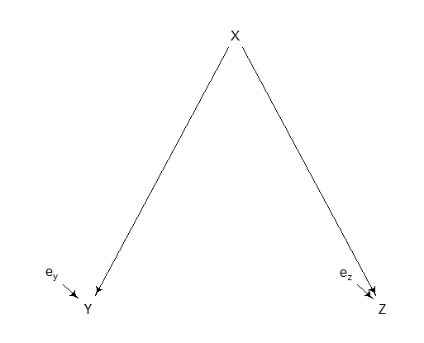
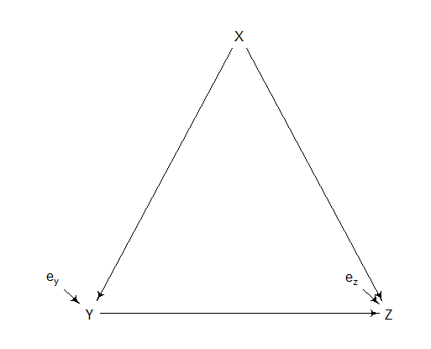
Common cause
Scenario 1
Scenario 2

Slide 6
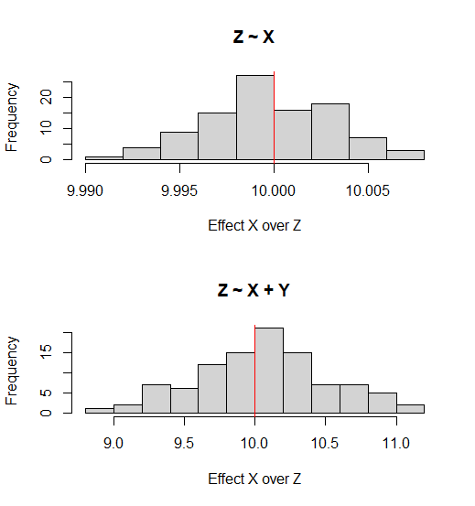
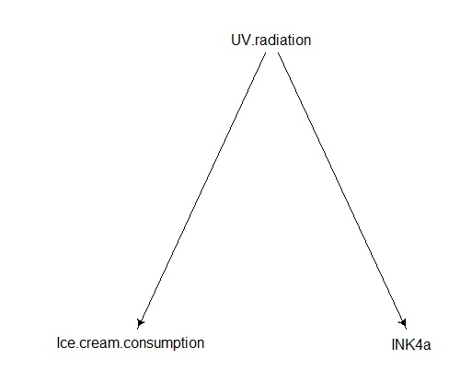
Scenario 1:
X → UV radiation
Y → Ice cream
Z → INK4a
INK4a ~ Ice cream: association, could be mistaken by causation (checking p value)
INK4a ~ UV radiation + Ice cream:
coefficient is the same with INK4a ~ UV radiation
s.d. of UV radiation increases
Frequency of estimates over N = 100 models

Slide 7
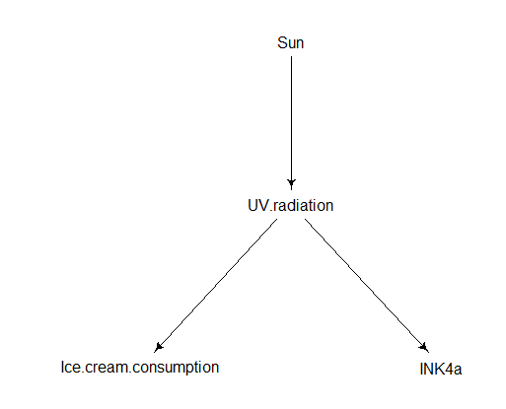
Scenario 1:
X → UV radiation
Y → Ice cream
Z → INK4a
A → Sun
Sun only relevant when INK4a ~ Sun. Implied conditional independencies:
INK4 _||_ Ic.. | UV.r
INK4 _||_ Sun | UV.r
Ic.. _||_ Sun | UV.r
INK4a ~ Sun + UV radiation: variance UV radiation increases -> when s.d ↑, variance in estimate is decreased.

Slide 8
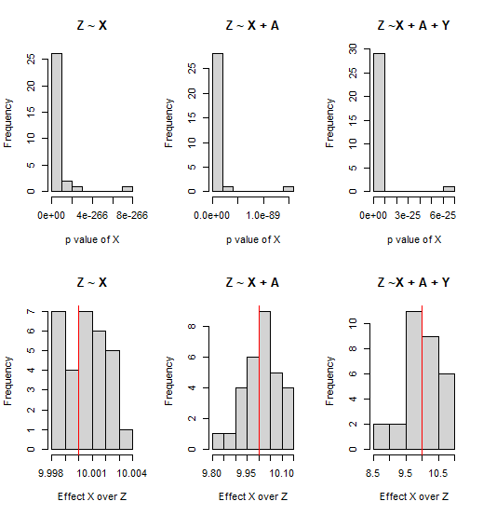
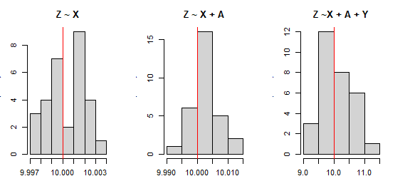
Scenario 1:
X → UV radiation
Y → Ice cream
Z → INK4a
A → Sun
Frequency of estimates of X over N = 30 models, when s.d. of X is 1 and when s.d. of X is 10
s.d. X = 10
s.d. X = 1

Slide 9
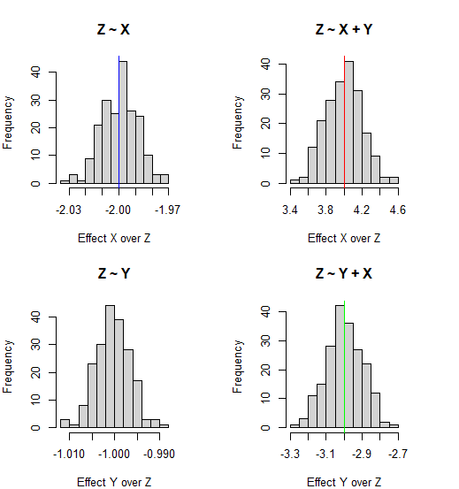
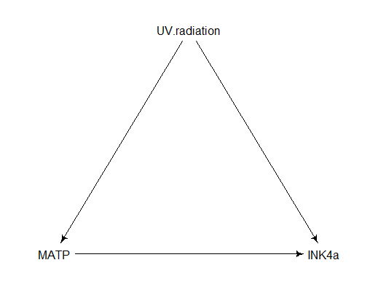
Scenario 2:
X → UV radiation
Y → MATP
Z → INK4a
Direct effect -> b_xz
Total effect -> b_xz + b_yz*b_xy
Effect of Y -> b_yz
Only when INK4a ~ UV radiation + MATP we can discern the direct effect of X.
Frequency of estimates of X and Y over N = 100 models
Notes:
Mencionar q el efecto indirecto se puede calcular con el total menos el directo

Slide 10
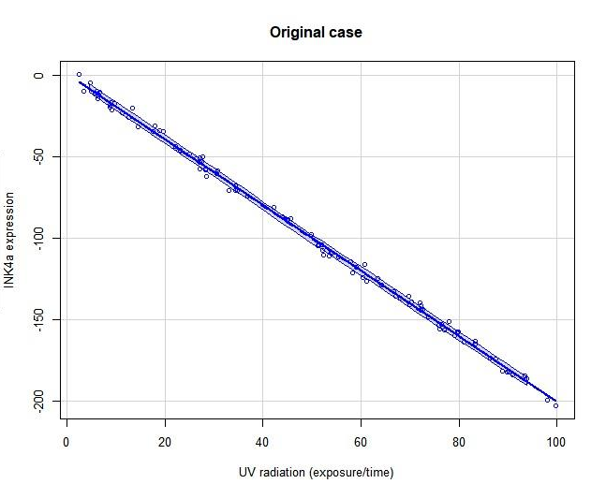
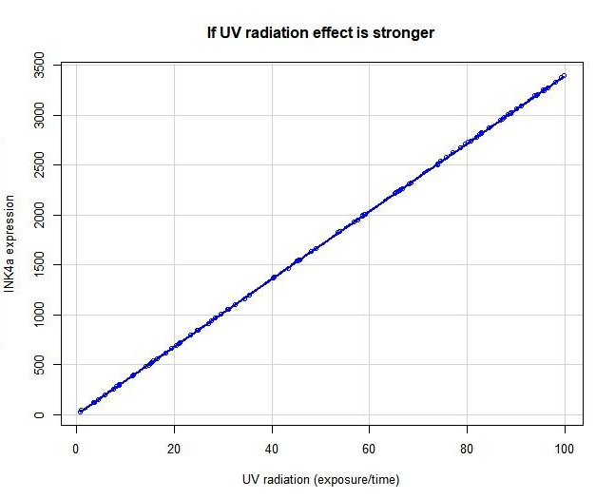
Scenario 2:
N = 100
b_xz = 4
b_xz = 40
Notes:
More on direct and total effects on the vignette and the code!!!
CAMBIAR EJES

Slide 11
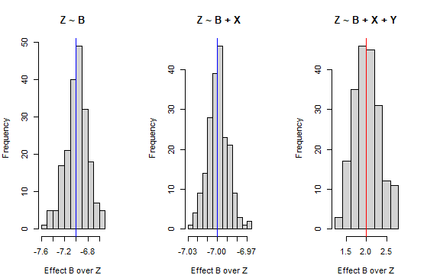
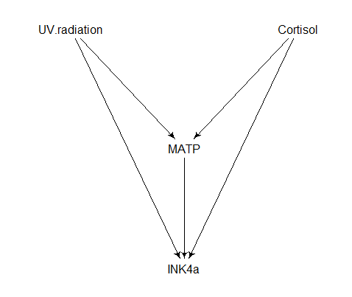
Scenario 2:
X → UV radiation
Y → MATP
Z → INK4a
B → Cortisol
When INK4a ~ Cortisol + UV radiation, total effect of each + reduced variance of estimates.
Notes:
PONER LEYENDA

Slide 12
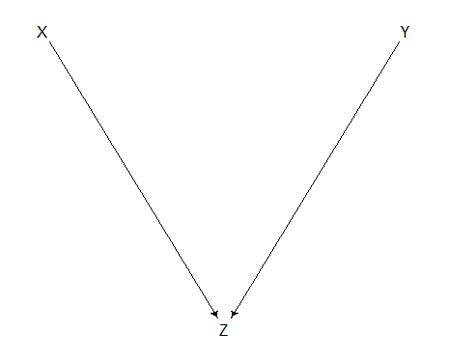
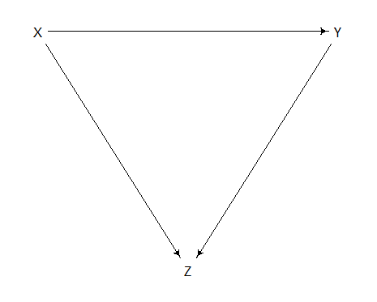
Common effect
Scenario 1
Scenario 2

Slide 13
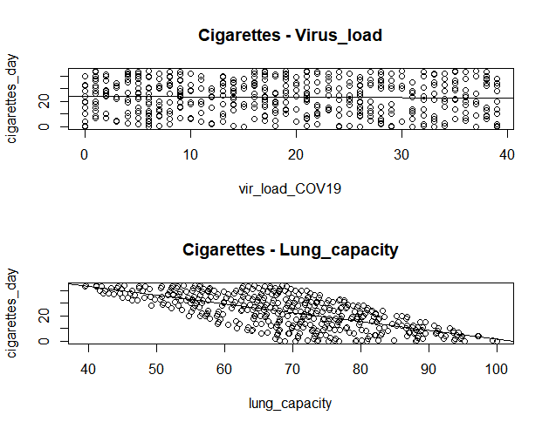
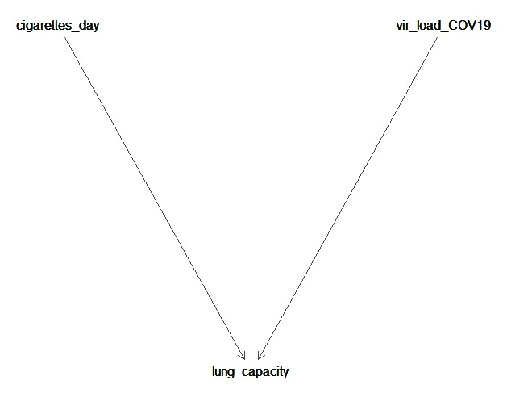
Scenario 1:
Cig_day ~ vir_load_COV19: no association
Cig_day ~ vir_load_COV19 + lung_capacity: association between cigarettes and virus load arises

Slide 14
Scenario 1:
 | Cigarettes/day ~ Viral load COV19 | Cigarettes/day ~ Viral load COV19 + Lung capacity
Estimate | -0.047 | -1.143e+00
P value | 0.35 | <2e-16***

Slide 15
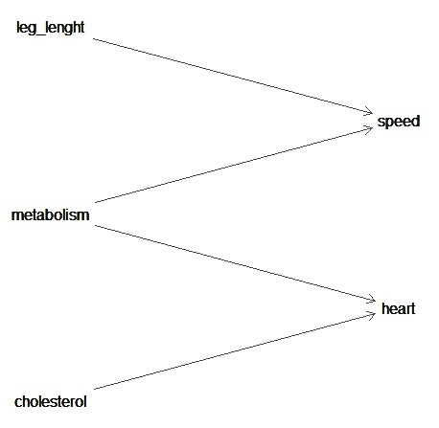
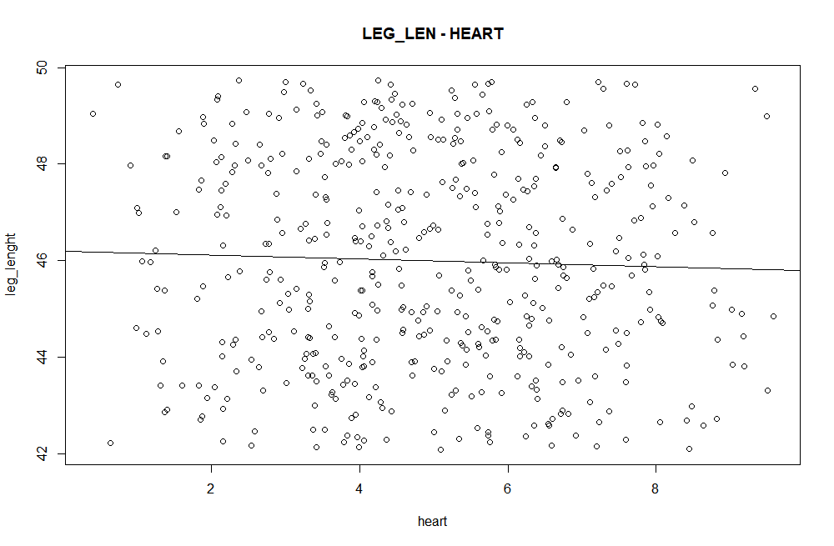
Scenario 1:
A more complex case: the runner.
leg_lenght ~ heart: there should be no association
leg_lenght~ heart+ speed: association between the length of your legs and heart diseases arises

Slide 16
Scenario 1:
A more complex case: the runner.
 | Leg length ~ heart | Leg length~ heart + speed
Estimate | -0.047 | -1.143e+00
P value | 0.35 | <2e-16***

Slide 17
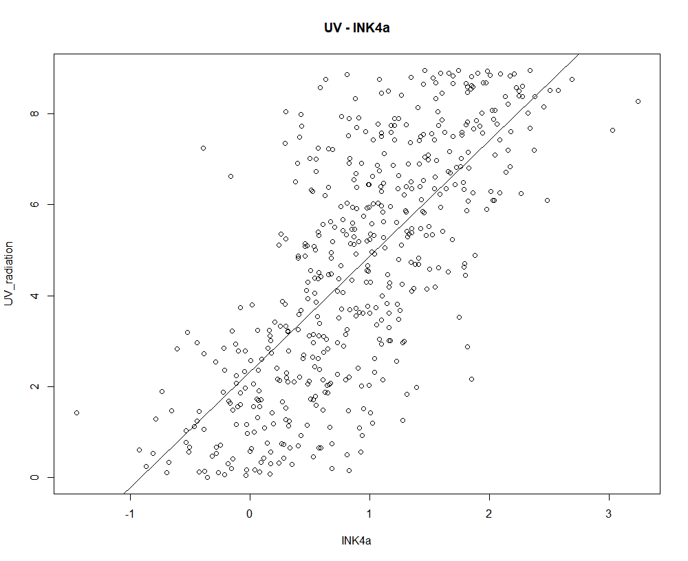
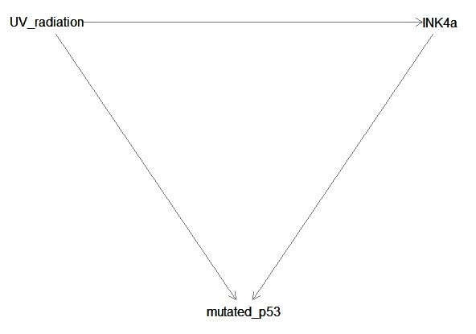
Scenario 2:
UV_radiation ~ INK4a: positive association
UV_radiation ~ INK4a + mutated_p53: association between UV radiation and INK4a turns negative

Slide 18
Scenario 2:
 | UV radiation ~ INK4a | UV radiation ~ INK4a + mutated p53
Estimate | 2.548 | -2.836
P value | 2.742e-83 | ~0

Slide 19
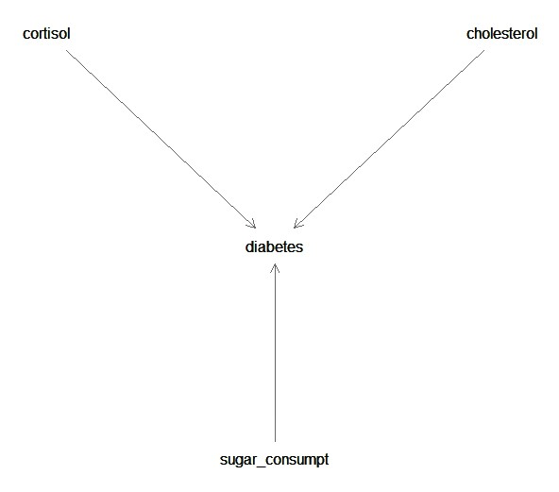
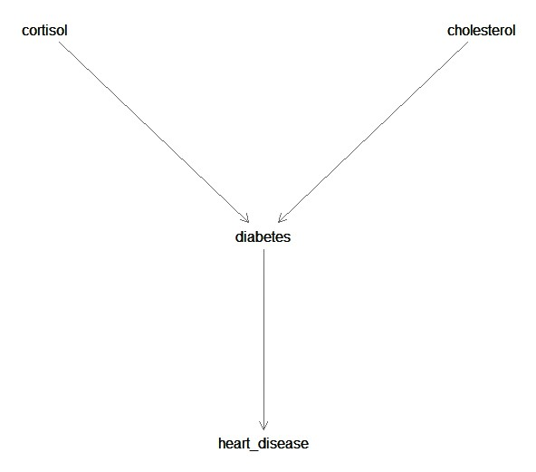
Ancestors and descendants:

Slide 20
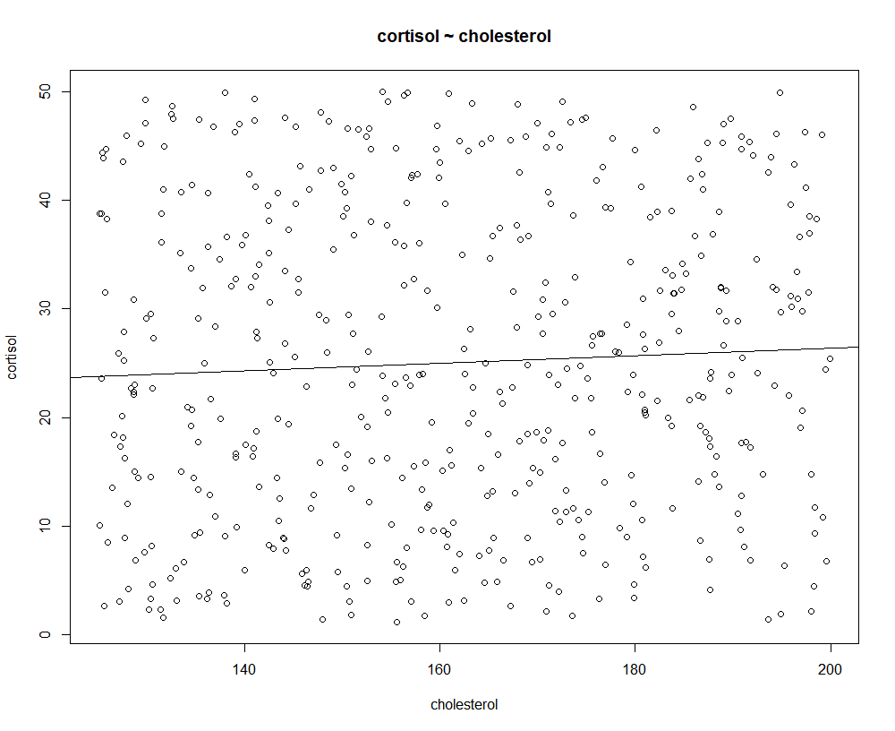
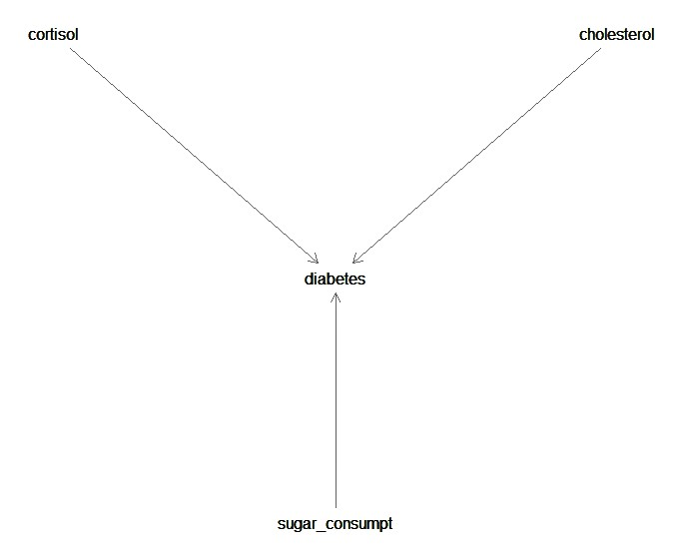
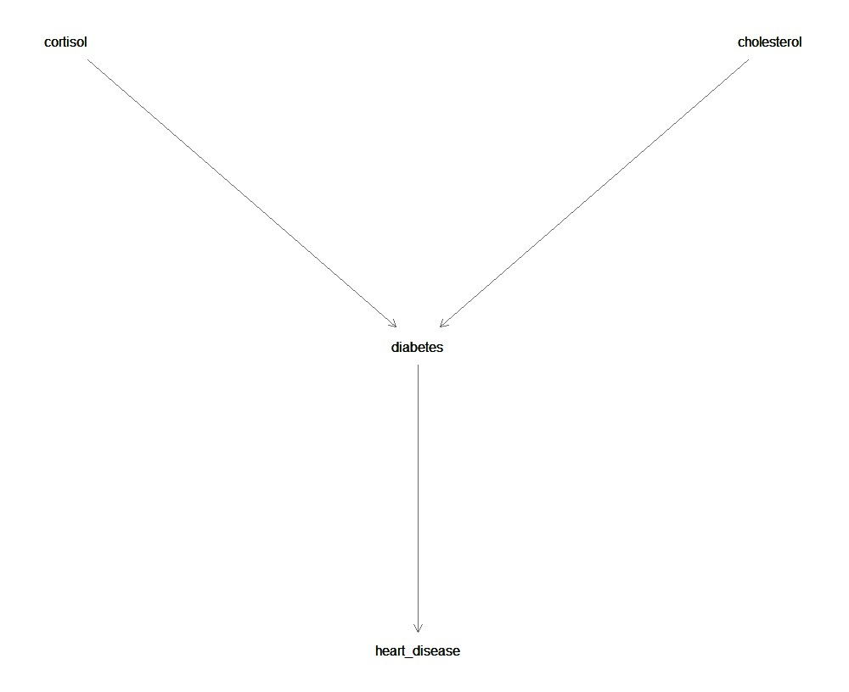
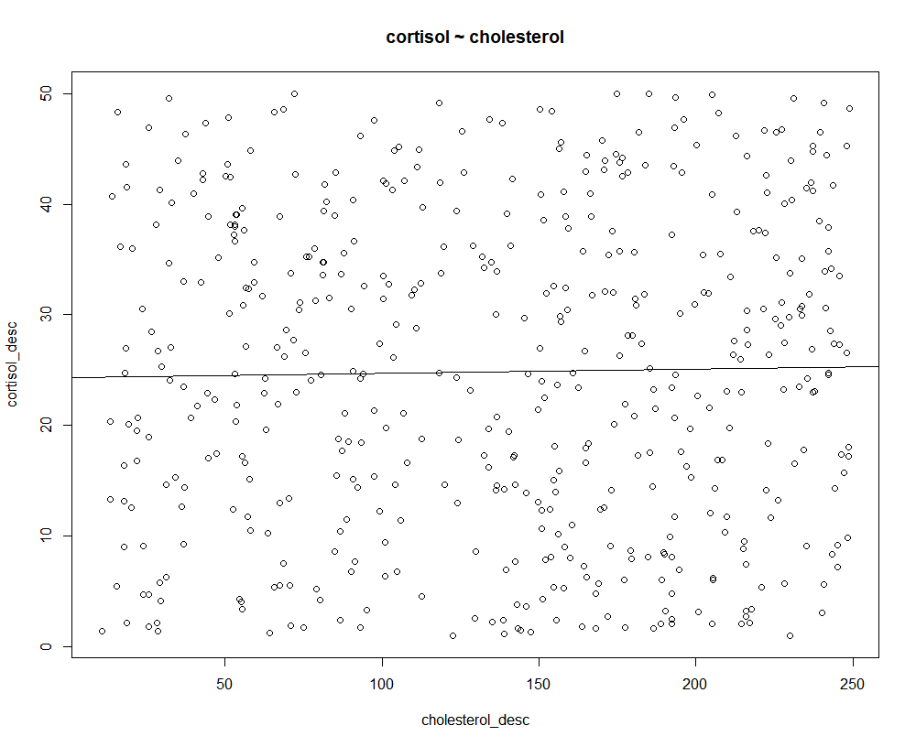
Ancestors and descendants:

Slide 21
Ancestors and descendants:
 | ANCESTOR |  |  | DESCENDANT
 | Cortisol ~ Cholesterol | Cortisol ~ Cholesterol + Diabetes | Cortisol ~ Cholesterol+Sugar | Cortisol ~ Cholesterol | Cortisol ~ Cholesterol + Diabetes | Cortisol ~ Cholesterol + Heart disease
Estimate | 0.0351 | -0.061 | 0.0352 | -0.009 | -0.593 | -0.593
P value | 0.235 | 2.406e-05*** | 0.233 | 0.281 | 6.266e-311*** | 5.151e-310***

Slide 22
Complex cases

Slide 23
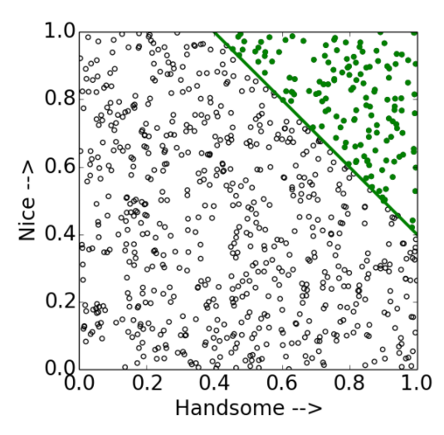
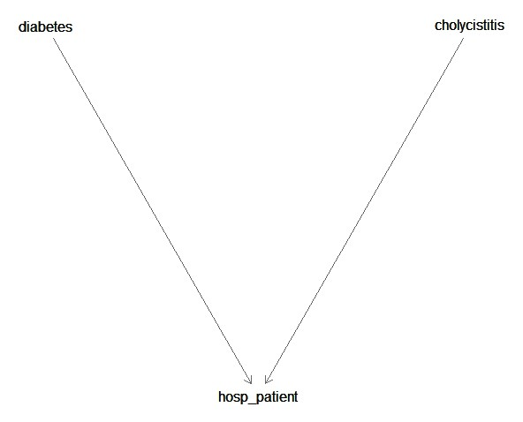
Berkson’s paradox / selection bias / (why are handsome men such jerks?)
The Berkson's paradox produces a selection bias, and it is caused by systematically observing some events more than others.
Fun example: why are handsome men such jerks?

Slide 24
Berkson’s paradox / selection bias / (why are handsome men such jerks?)
 | Diabetes ~ Cholecystitis | Diabetes ~ Cholecystitis + Hospital patients
Estimates | 0.698 | -7.361
P_values | 0.303 | 0.0037**

Slide 25
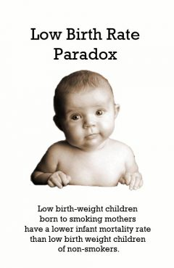
Simpson’s paradox
Extreme case of confounding: one trend when there are different groups, opposite trend when combined.
Credits to Paradox Parkway, 2001

Slide 26
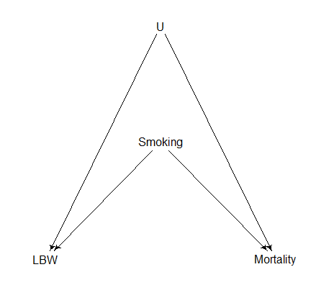
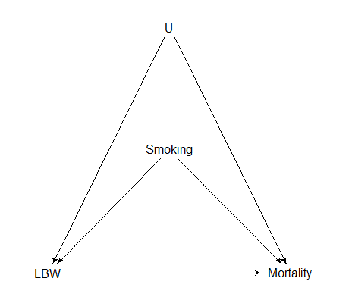
LBW paradox

Slide 27
LBW paradox
The estimate for Smoking is:
When Mortality ~ Smoking: 0.2332309
When Mortality ~ Smoking + LBW: -0.979942
The estimate for Smoking is:
When Mortality ~ Smoking: 0.2005967
When Mortality ~ Smoking + LBW: -0.9414655

Slide 28
Backdoor criteria:
Condition on a set of variables in which:
All back door paths between X and Y are blocked after conditioning on them → block all non causal paths.
No variables in Z are descendants of X.

Slide 29
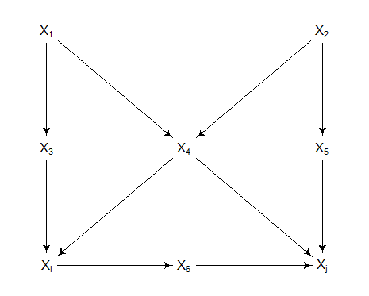
Identify backdoor paths
2. Select variables that block all paths:
X4
function path from dagitty
↓
take away causal paths
Treatment
Outcome

Slide 30
All back door paths between X and Y are blocked after conditioning on them
No variables in Z are descendants of X.
Confounder, but also collider of two confounders.
Condition on one of the confounders, or their descendants: control all possible source of confounding.
XJ ~ XI + X4 + X5
XJ ~ XI + X4 + X1
…

Slide 31
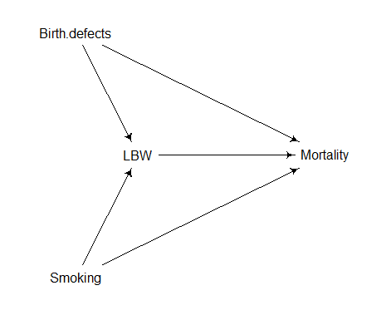
Can condition on BD, blocks only backdoor path
Can’t condition on anything else!

Slide 32
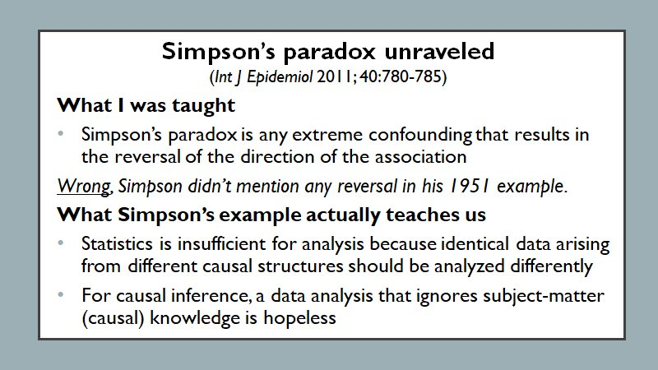
Simpson’s paradox
Disclaimer: there is more than confounding!
(Hernan, 2017)

Slide 33
Room to improve
Improve output appearance
Efficiency + function optimization
Code homogeneity (in cause, effect and complex cases)
Improve documentation (easy to understand) -> package!

Slide 34
Conclusion:
When doing data analysis:
MUST know the causal structure of the subject, or you may end up making wrong conclusions
CAN’T forget the causal context or reduce the variables to statistical terms
A model is a model.
Regarding code: still a lot of room to improve!
More on: https://github.com/igarcia17/causal_inference
Notes:
In the words of the data anal yst

Slide 35
Thank you for your attention!

